Slide 1
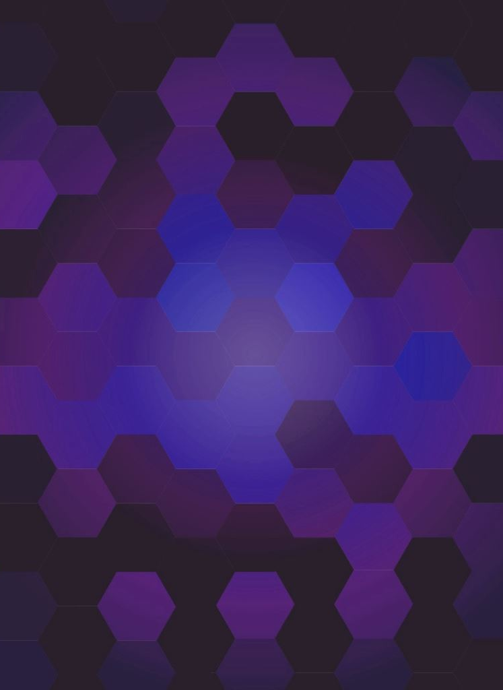
CSC492H5 UX Design Fundamentals
Notes:
Questions from Petersen:
When creating profiles, REALLY think about making them different. Think about accessibility, think about genders, think about different usecases.
How does incrementally improving the fidelity apply to VC funding?
For the benefit of VC: Can cater content towards the VC’s interest. You don’t need to dive deep into dev issues with them, so narrow the scope to the business model or income/cashflow statements with them. Narrow the scope so the other stuff doesn’t distract from the objective.
For the benefit of the Dev: In the example of the black and white design mockup, what are you trying to do? You are trying to limit the scope to your competencies or the focus of your critique. In this case, you want critique on the design choices and the functionality of the app at this stage. Adding colour and super-refining the UI isn’t helpful to the user, nor you in getting the feedback you want.
From the perspective of limiting the scope of your competencies, its sort of like that ted talk of a pick-pocketer, where he manipulates your attention to focus on what he wants you to focus on. Very powerful tool!

Slide 2
Week 1: Ideation, Articulation, Development
Topics covered:
Expand & Explore
What does it do?
How does it work?
Who’s going to benefit?
Refine & Edit
Why would someone use this?
Notes:
Week 1 was sort of a recap of Course 1 material and built upon those concepts through a UX lens.
We discussed expanding and exploring all the functionality that our app could take, then refining and editing it to a cohesive use case by a particular target group. The process was by answering the following questions:
In the Ideation & Articulation phase we asked “What does it do?” and brainstormed some use cases and goals of the app.
In the Research & Development phase, we asked “How does it work?” and explored some competitors.
In the Audience & Rationale phase, we asked “Who’s going to benefit?” and created personas of the average user.
Finally, in the Goals & Outcomes phase, we asked “Why would someone use this?” and thought about what MY goals are as the developer of the app.
We created a hierarchy of importance within each category to ensure everyone’s goals are aligned.
I found going through this process to be pretty productive.
Again, the experience was a little tainted because I’m not working on Nox from scratch, but it was especially helpful to think about potentially new uses cases and cut back on weaker ones.

Slide 3
What does it do?
Who benefits from the app?
Who are some competitors?
Why would someone use this?
What are your goals as the developer?
Notes:
For Nox, I’ll just highlight the top 2 from each section:
What does it do?
Allows students to ask questions anonymously to an instructor in a lecture setting.
Allows instructors to poll their students.
Who benefits from the app?
I​nstructors that want to be efficient with their time, but want students to engage with the lecture
S​tudents that are shy to ask questions publicly
Persona: James, Waterloo, 18-year old freshman CS student, attentive and curious, shy and hates drawing attention to himself.
Competitors:
S​lido
OnlineQuestions.org
Why would someone use this?
To introduce a new level of classroom engagement in a populist and efficient manner. The questions that most students have get answered in an efficient manner at any given moment.
What are your goals as the developer?
1. G​ain experience going through the process of designing, building and iterating on an app.
2. Provide a useful app that's features can be expanded upon.

Slide 4
Week 2: Mapping, Testing, Envisioning
Topics covered:
Mapping
Content and Interaction maps
Testing
Paper Prototyping
Envisioning
Visual Development.
Site Maps
Notes:
This week we got more hands on and dove right into fleshing out our app’s interactions and content from page to page – focusing mainly on the user experience.
There were deliverables pretty much every step of the way, so I’ll explain each one as I walk through what I did for Nox.

Slide 5
Notes:
We created content and interaction maps based on the functionality of our app discussed in the previous week. A content map highlights what type of content will be on each page of our app. Since Nox is very basic, I combined what would have been several different content maps into a single one with arrows representing the next page.
Dark Blue: Nox Pages
Light Blue: Off-sight Page
Grey: Event Trigger
Brown: Content
Dotted line is not an event triggered remotely.
Line shows content belonging
Arrow shows navigation

Slide 6
Notes:
An Interaction map highlights the interactions that take place in the app – like a flow chart of events.
Since I combined the content maps into a single map for Nox, the content and interaction map look quite similar.

Slide 7
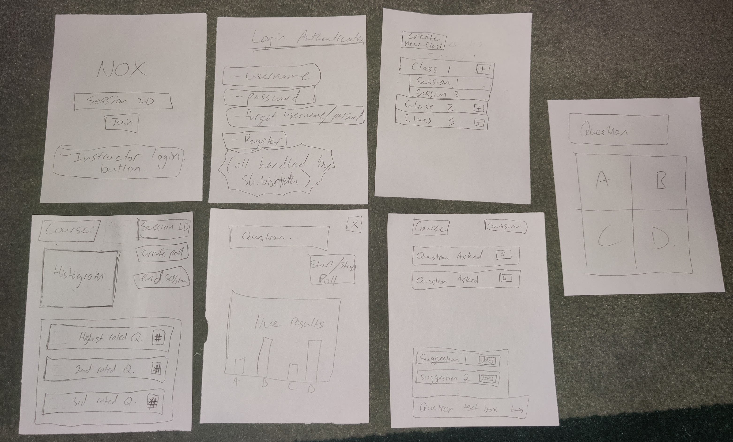
Notes:
Next was the testing stage where we created a paper prototype. The purpose of this prototype that is meant to test the flow chart and walk through a typical use-case with somebody.
It’s meant to be non-visual and solely focus on the content, but I think rough visuals would make it a little easier for testers to make sense of what the heck was going on.
There were a couple more things on testing such as the 10 Usability Heuristics for UI Design by Jakob Neilsen which were interesting. They’re way back from the 90s but definitely still relevant today.

Slide 8
Notes:
And finally, here is a sitemap. A sitemap is meant to be a non-visual prototype that combine your content map, interaction map, and paper prototype after you’ve worked through the testing iterations and refined the flow.
It’s meant to take your design to the next level of fidelity. We now know how many screens we need, what content we’ll have on each screen, and how they will interact with each other.

Slide 9
Week 3: Wireframing and UI design
Topics covered:
Wireframing
Minimalist and B&W
Wireframe Map
Colour and detailed
Notes:
Onto week 3. This week is where things really started to take off fast.
It was just back-to-back wireframing while adding more and more detail to the UI design with every step. It felt like the project was really coming together at this stage.
There were 3 iterations to this process:
We converted the sitemap pages to black-and-white, minimal design pages.
Next, we refined the pages by adding colour and detail to the designs.
Then we built a wireframe map. A wireframe map is laying out the refined screens in some sort of logical hierarchy. For example, a downward funnel or grouping pages and their subpages together, etc.
I sort of jumped the gun here.. This week’s focus was to mainly refine the UI visuals and do a mockup wireframe. I just went ahead and did the actual wireframing while making UI refinements.
<< Show the demos >>

Slide 10
Week 4: Digital Prototype
Topics covered:
Feeling Real
Believable User Interface
Create a Clickable Prototype
Familiarized myself with Figma
Believable User Experience
Believable Content
Scale and Physicality
Paths and Responses
Notes:
This week was all about making the last set of refinements to make a believable, clickable prototype.
The goal here is to make naïve testers believe this is a functional product, without having written a single line of code.
We refined our UI in the previous week to make it look believable. This took refining the scale and physicality of interactive components to match the device we’ll be using.
As an example, buttons on phones will be different scale or location than buttons on a desktop.
This week we refined the UX. This took refining the paths and responses of interactions such as button clicks or gestures.
Again, we need to keep in mind the type of device this will be used on.
We discussed the different methods of developing prototypes, I’ll save you the details, but I decided to use Figma since it’s a popular tool used in the industry. Aaaand it was free

Slide 11
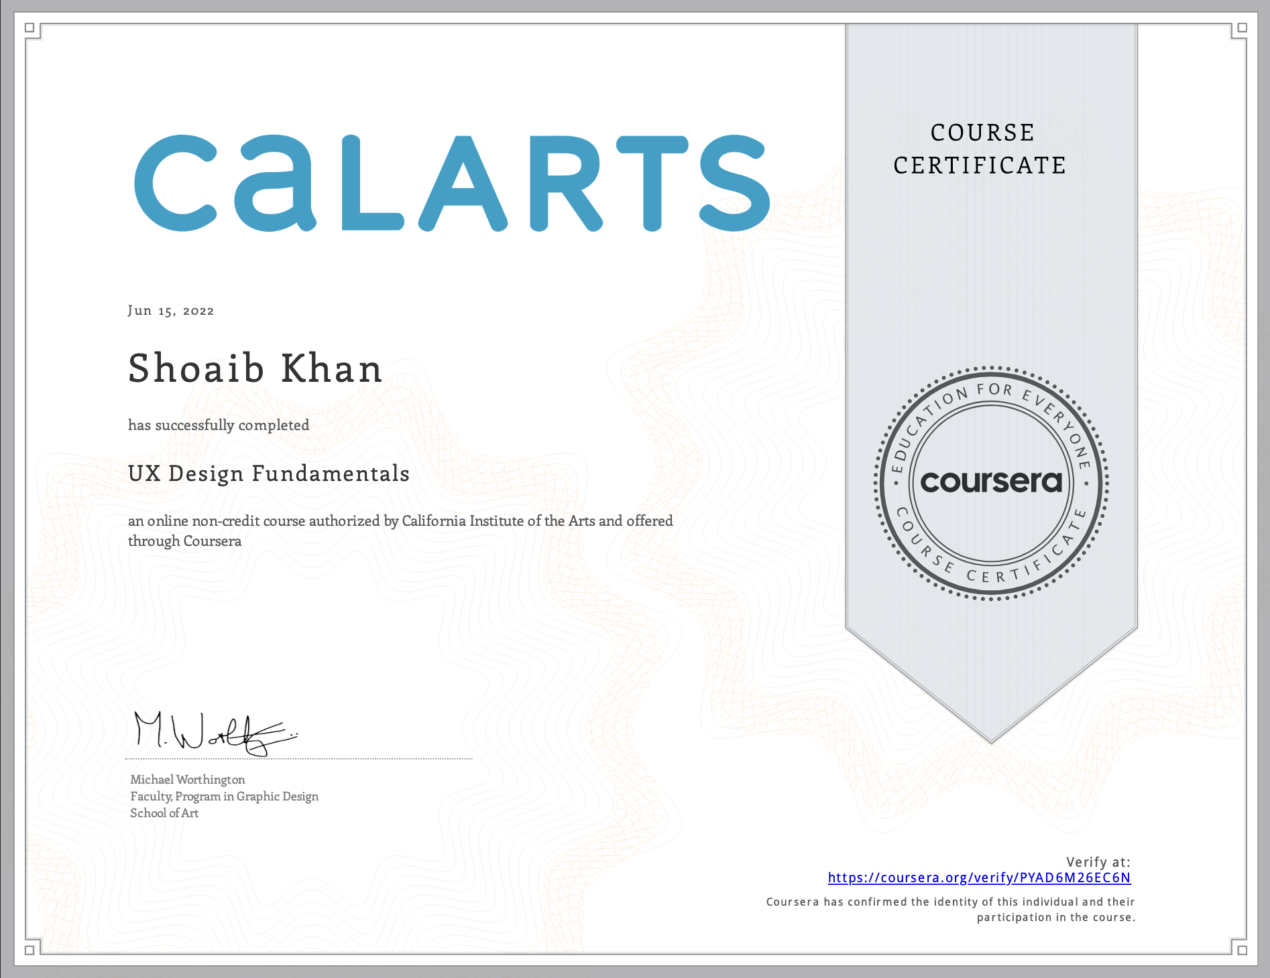
Notes:
But any who, that wraps up this course.
Honestly, this course has me PUMPED for what’s to come. I’m really happy so far with the quality of instruction and how much we were able to cover.
I’ve had another personal project that I’ve been wanting to build out for over a year now that’s just been on the back burner. I’ve been stuck on, what I now know to be, the ideation and goal setting phase.
This course and the previous one provided me a step by step process that makes this daunting task of getting started much more manageable.
And as I mentioned during the last presentation, what I realized is that going through this process isn’t bullshit at all..
Taking these iterative steps actually ends up SAVING time once you become comfortable with the software. Its like you noted in our last meeting, each of these steps are steady refinements and increased levels of commitment, both in time and money.
After this course, I can confidently say, I will definitely be following this process in the future.
Next 2 courses:
Improve UX skillset by delving into user research and understanding your target audience, setting goals and defining strategy, establishing scope and structure, and finally developing a compelling look and feel.
Apply these skills to a single, large-scale project: developing a comprehensive plan for a responsive website which you will develop over two courses.
Create different personas.

